Slide 1
VEHICLE SECURITY
SYSTEM

Slide 2
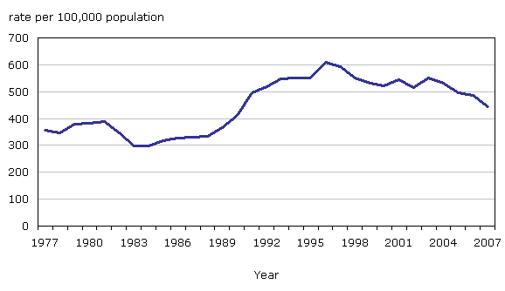
INTRODUCTION:
There were an estimated 721,053 thefts of motor vehicles nationwide in 2012.
The estimated rate of motor vehicle thefts was 229.7 per 100,000 inhabitants.
The estimated number of motor vehicle thefts increased 0.6 percent in 2012 when compared with the 2011 estimates

Slide 3

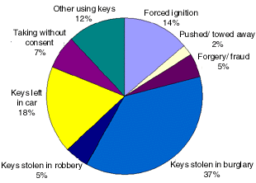


The increasing number of thefts has made it necessary to employ certain functionalities for vehicle security. The product aims at not only securing the prized possession but helping in catching the culprit as well so that future cases of the same can be avoided. It is a low cost solution to all the alternatives available in the market. Interactive as well as efficient, it makes use of GSM to notify the owner in case of vehicle theft and GPS Module to track the location of the system.

Slide 4
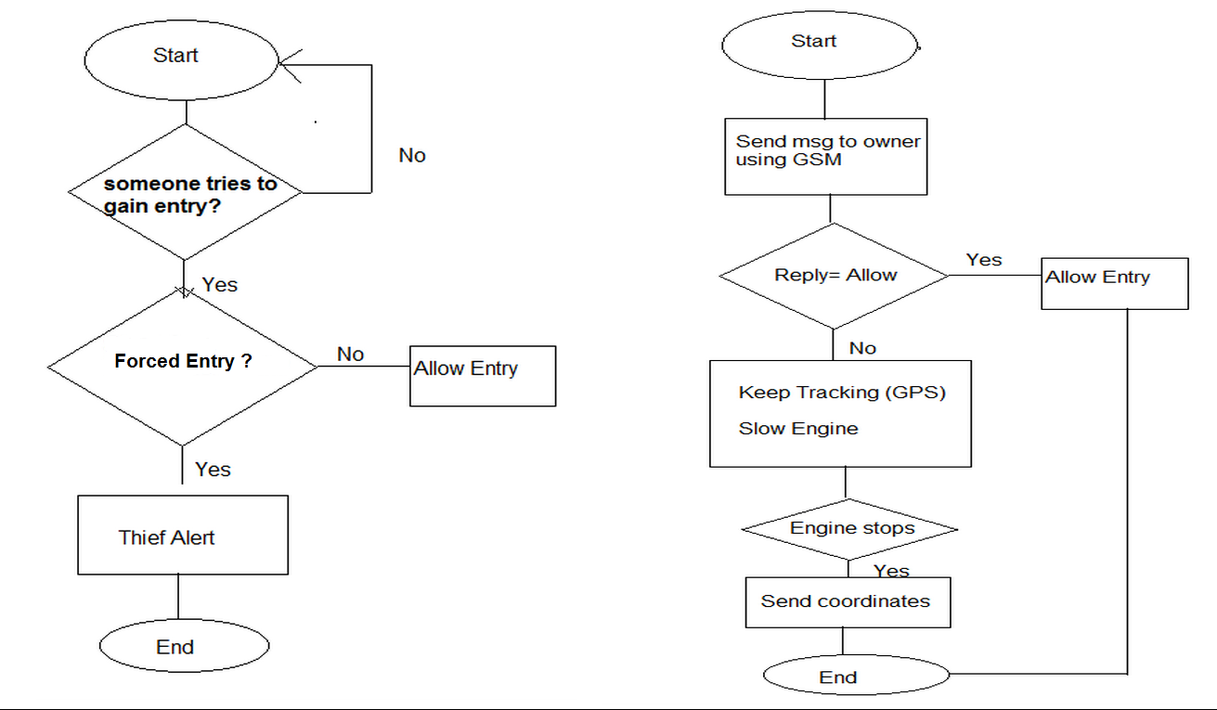
THIEF ALERT
INITIAL
OPERATION

Slide 5
COMPONENTS USED:
ARDUINO UNO
GSM SIM900
GPS MODULE

Slide 6
ARDUINO UNO

Slide 7
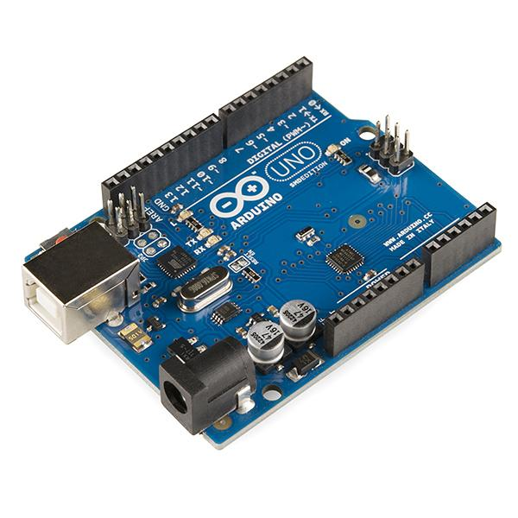
Open-source prototyping platform.
Can be interfaced with shields and other circuits.
Serial communications interfaces
Provides an integrated development environment (IDE) which includes support for C, C++ and Java.
ATmega328 microcontroller
Input voltage - 7-12V
14 Digital I/O Pins (6 PWM outputs)
6 Analog Inputs
32k Flash Memory
16MHz Clock Speed
runs on Mac, Windows, and Linux

Slide 8
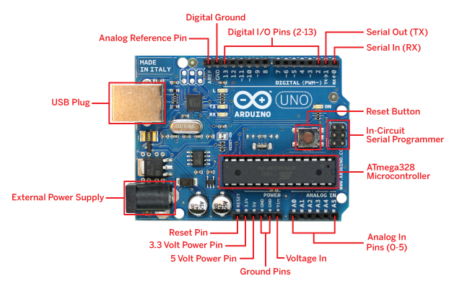
PIN DIAGRAM

Slide 9
GSM MODULE

Slide 10
DESCRIPTION
Global system for mobile communication (GSM)
Globally accepted standard for digital cellular communication
Operates in the 900MHz and 1.8GHz bands(Europe) and the 1.9GHz and 850MHz bands in the US.
Circuit-switched system that divides each 200 kHz channel into eight 25kHz time-slots.
Uses Time Division Multiple Access (TDMA) technique for transmitting signals.
The working is based on commands starting with AT (which means Attentions) and finish with a character
The AT commands are given to the GSM modem with the help of PC or controller.
Differs from its predecessor technologies in that both signaling and speech channels
are digital, and thus GSM is speech channels are digital.
GSM is considered a second generation (2G) mobile phone system.

Slide 11
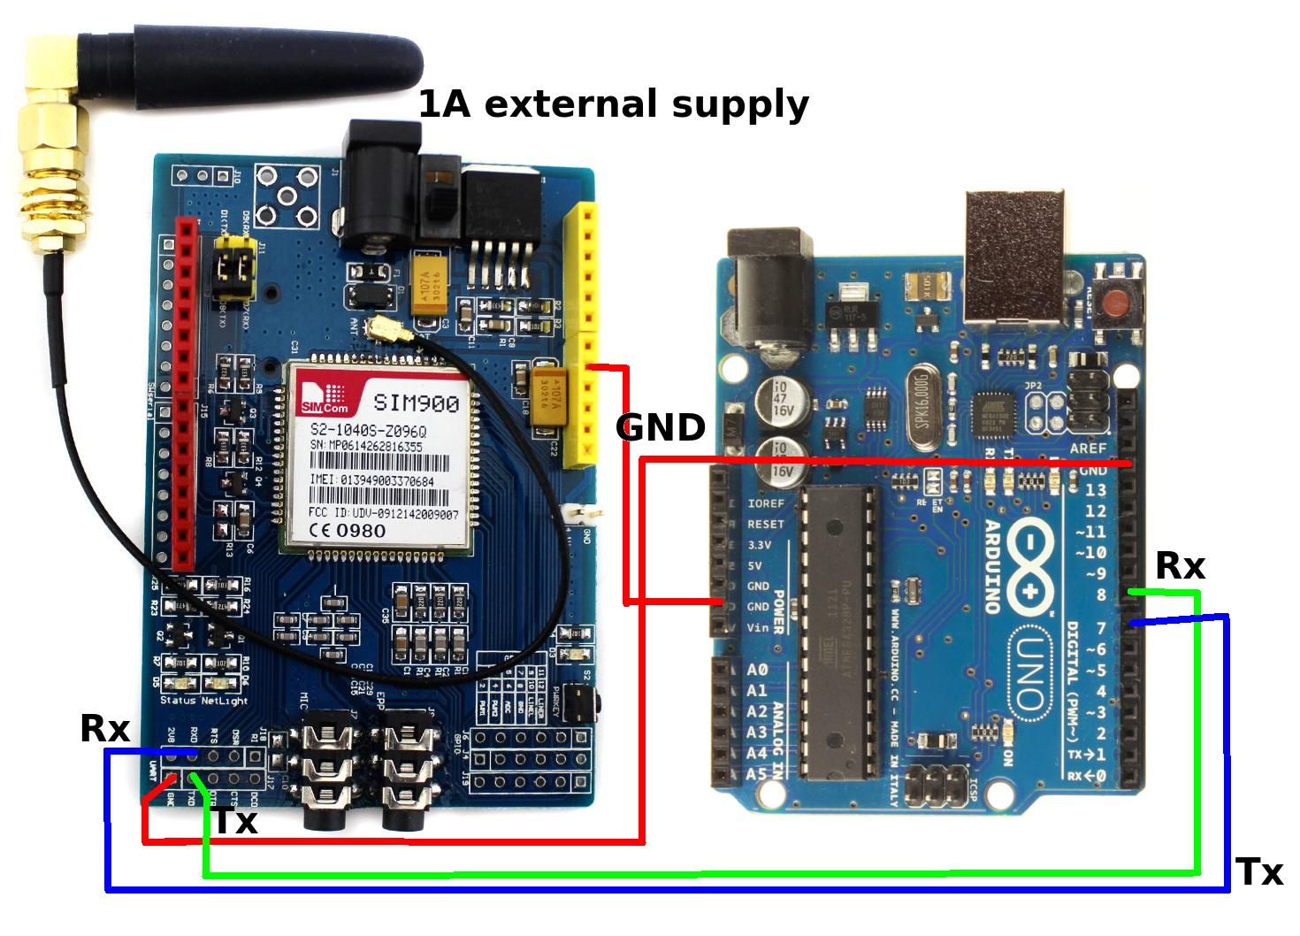
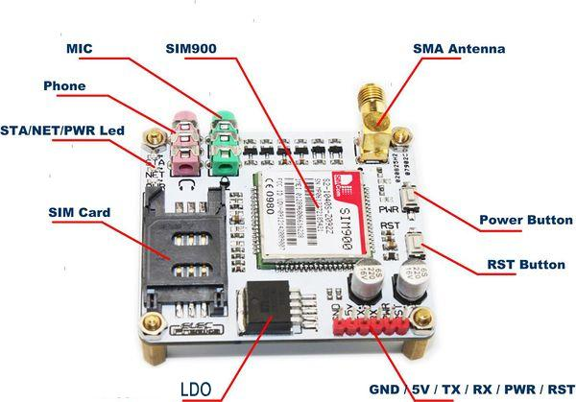
GSM INTERFACING
GSM PIN DIAGRAM

Slide 12
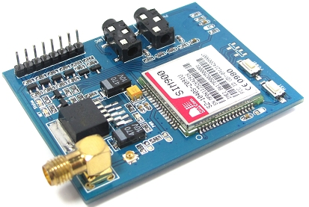
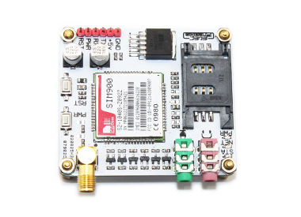
Commands and response of GSM module
COMMAND | RESPONSE | DESCRIPTION
AT+CMGF | OK | Specifies the input and output format of the short messages. 0 for PDU mode and 1 for text mode
AT+CMGS |  | Sends a message
AT+CMGR=* |  | Reads a message. * is the number of message
ATD********* |  | ********* is the number to call

Slide 13
GPS MODULE

Slide 14
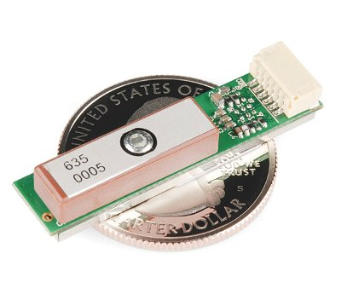
DESCRIPTION
Space-based global navigation satellite system (GNSS)
Provides reliable location and time information at all times.
Comprises of three segments
SPACE SEGMENT: 24 satellites circling the Earth every 12 hrs on 6 orbital planes with 4 satellites in each plane that provide ranging signals & data messages to users.
CONTROL SEGMENT: Monitors and controls satellites’ subsystem health, status and signal integrity
USER SEGMENT: Receiver equipment performs navigation, timing, or other related functions
Works on the principle of ‘Trilateration’.
Highly accurate positioning of the range 50 to 100 meters.
Using differential correction, users can get positions accurate to within 5 meters or less.

Slide 15
Trilateration
To uniquely define a location on Earth, the GPS receiver has to know two things:
The location of at least three satellites above you
The distance between you and each of those satellites
GPS receiver figures both of these things out by analyzing high-frequency, low-power radio signals from the GPS satellites.
Based on time delay adjustments, the location is determined with high accuracy.

Slide 16
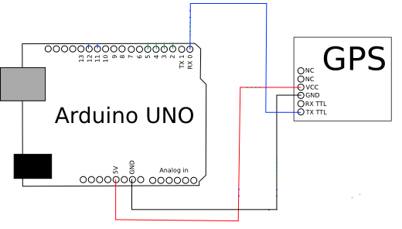
GPS INTERFACING
The module connects to the Arduino through a 4800 bps TTL-level interface (8 data bits, no parity, 1 stop bit, non-inverted).
Only 3 wires are needed to read the module's GPS data.
PIN CONNECTIONS The GND and Vcc of Arduino are connected to respective pins on GPS Module.
The TX of GPS is connected to RX of Arduino UNO.

Slide 17
 | GPS | GSM
Definition | Global positioning System Satellite-based navigation system Developed by the United States Department of Defence. | Specification of wireless network infrastructure Developed by the European Telecommunications Standards Institute.
Technology | Triangulation to at least three or four of the 24 satellites that orbit the earth. | An object‘s position is determined using signal strength and triangulation from base stations.
Features | Helps to find location and tracking of the vehicle | Can stop the vehicle when unauthorised person tries to steal the vehicle.
Vehicle Tracking | Digital maps, etc. are used to track the location in real time. | Phone‘s international mobile equipment identity number, etc. are used to track the location of a vehicle.
Accuracy | Comparatively difficult in area surrounded by tall buildings. | Base stations are capable of providing locations in areas like tunnel and dense areas.
Advantage | Provides the exact location Provides the exact latitude and longitude Helps in searching the local area for nearby amenities Assists in improving the accuracy for weather forecasts. | World wide roaming The facilities of GSM are highly protected Reasonable Devices and Facilities The GSM expertise usages five bands of MHz rate; 450, 850, 900, 1800 and 1900 MHz.

Slide 18
PRODUCT DESCRIPTION

Slide 19
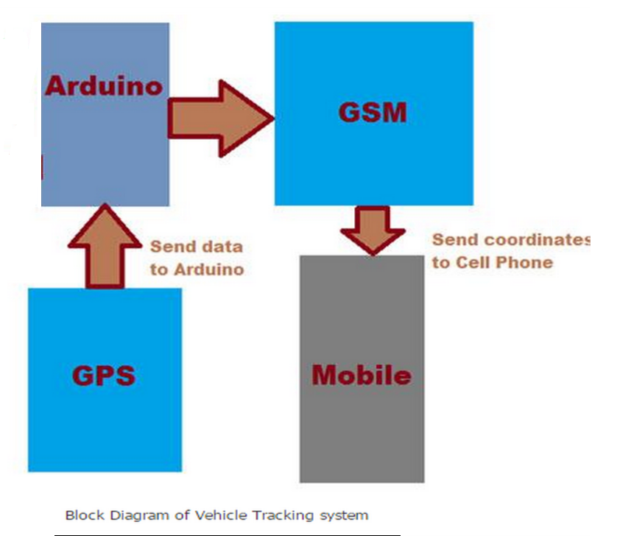

Slide 20
INITIALISATION
In case of forced entry, the sensors in the vehicle send an interrupt to the arduino.
The arduino then sends a control message to the GSM SIM900 module to alert the owner of the vehicle.
The GSM module sends an ALERT message on the registered mobile number.

Slide 21
CONFIGURING GSM
Network led pattern:
Status SIM900 behavior
Off SIM900 is not running
64ms On/ 800ms Off SIM900 not registered the network
64ms On/ 3000ms Off SIM900 registered to the network
64ms On/ 300ms Off GPRS communication is established
The code is tested with SIM900A and Arduino UNO. Connect the Tx and Rx pins of arduino pins to Rx and Tx pins of GSM Modem.

Slide 22
MODULE PROCESSES
void Response() // Get the Response of each AT Command
{
int count = 0;
Serial.println();
while(1)
{
if(Serial.available())
{
char data =Serial.read();
if(data == 'K'){Serial.println("OK");break;}
if(data == 'R'){Serial.println("GSM Not Working");break;}
}
count++;
delay(10);
if(count == 1000)
{
Serial.println("GSM not Found");
break;
}
}
}
void loop()
{
if(limit==0)
sendalert();
delay(10000);
if(limit==1)
RecSMS();
}
void Config() // This function is configuring our SIM900 module i.e. sending the initial AT commands
{
delay(1000);
Serial.print("ATE0\r");
Response();
Serial.print("AT\r");
Response();
Serial.print("AT+CMGF=1\r");
Response();
Serial.print("AT+CNMI=1,2,0,0,0\r");
Response();
}

Slide 23
void sendalert()
{
SIM900.print("AT+CMGF=1\r");
Serial.print("AT+CMGF=1\r"); // AT command to send SMS message
delay(2000);
SIM900.println("AT + CMGS = \"+918130402277\"");// recipient's mobile number
Serial.println("AT + CMGS = \"+918130402277\""); // recipient's mobile number
delay(1000);
SIM900.println("Invalid access"); // message to send
Serial.println("Invalid access");
delay(200);
SIM900.println((char)26); // End AT command with a ^Z, ASCII code 26
Serial.println((char)26);
delay(200);
SIM900.println();
delay(5000); // give module time to send SMS
limit++;
}
SendMessage() –
Function to send an SMS
Set our GSM module to Text mode first by sending an AT Command “AT+CMGF=1″ to SoftwareSerial port.
Use the mySerial.println() function.
Writes data to software serial port (the Tx pin of our Software Serial – that is pin 10)
Will be captured by GSM module (through its Rx pin)
Select the mobile number to send the SMS.
This is achieved with AT command “AT+CMGS=\”+91xxxxxxxxxx\”\r” – where all x are replaced with the mobile number.
To send the actual content of SMS
The end of SMS content is identified with CTRL+Z symbol.
The ASCII value of this CTRL+Z is 26.
So send a char(26) to GSM module using the line mySerial.println((char)26);
Each and every AT command may be followed by 1 second delay. We must give some time for GSM module to respond properly
Once these commands are send to GSM module, you shall receive an SMS in the set mobile number.

Slide 24
void RecSMS() // Receiving the SMS and extracting the Sender Mobile number & Message Text
{
delay(5000);
if(Serial.available())
{
char data = Serial.read();
if(data == '+'){RcvdCheck = 1;}
if((data == 'C') && (RcvdCheck == 1)){RcvdCheck = 2;}
if((data == 'M') && (RcvdCheck == 2)){RcvdCheck = 3;}
if((data == 'T') && (RcvdCheck == 3)){RcvdCheck = 4;}
if(RcvdCheck == 4){RcvdConf = 1; RcvdCheck = 0;}
if(RcvdConf == 1)
{
if(data == '\n'){RcvdEnd++;}
if(RcvdEnd == 3){RcvdEnd = 0;}
RcvdMsg[index] = data;
index++;
if(RcvdEnd == 2){RcvdConf = 0;MsgLength = index-2;index = 0;}
if(RcvdConf == 0)
{
Serial.print("Mobile Number is: ");
for(int x = 4;x < 17;x++)
{
MsgMob[x-4] = RcvdMsg[x];
Serial.print(MsgMob[x-4]);
}
Serial.println();
Serial.print("Message Text: ");
Serial.available() –
Checks for any data coming through serial port of arduino.
Returns the number of bytes available to read from serial buffer.
If there is no data available, it returns a -1 (value less than zero).
Serial.read() –
Reads all the data available on serial buffer (or incoming serial data if put otherwise).
Returns the first byte of incoming serial data.

Slide 25
for(int x = 46; x < MsgLength; x++)
{
MsgTxt[x-46] = RcvdMsg[x];
Serial.print(MsgTxt[x-46]);
if(MsgTxt[x]=='s' || 'S')
{
digitalWrite( 13, LOW);
sendgps();
}
else
{
validentry();
}
}
Serial.println();
RcvdCheck = 0;
RcvdConf = 0;
index = 0;
RcvdEnd = 0;
MsgMob[15];
MsgTxt[50];
MsgLength = 0;
Serial.flush();
}
}
}
}
RecieveMessage() –
To receive an SMS (a live SMS).
The AT command is “AT+CNMI=2,2,0,0,0″
Send this command to GSM module and apply a 1 second delay.
Send an SMS to the SIM card number put inside GSM module.
SMS you had sent displayed on your Arduino serial monitor.
If you want to read all SMS’s stored in your SIM card, send the following AT Command to gsm module – “AT+CMGL=\”ALL\”\r”

Slide 26
void sendgps()
{
bool newData = false;
unsigned long chars;
unsigned short sentences, failed;
// For one second we parse GPS data and report some key values
for (unsigned long start = millis(); millis() - start < 1000;)
{
while (ss.available())
{
char c = ss.read();
if (gps.encode(c)) // Did a new valid sentence come in?
newData = true;
}
}
float flat, flon;
unsigned long age;
if (newData)
{
SIM900.print("AT+CMGF=1\r");
Serial.print("AT+CMGF=1\r"); // AT command to send SMS message
delay(2000);
SIM900.println("AT + CMGS = \"+918130402277\"");// recipient's mobile number
Serial.println("AT + CMGS = \"+918130402277\""); // recipient's mobile number
delay(1000);
gps.f_get_position(&flat, &flon, &age);
Server unit uses GPS receiver to capture the current location and vehicle speed from the tracking antenna.
Location and speed data provided by GPS is not in human understandable format.
This raw data needs to be processed to convert it into useful information that can be sent to the mobile phone through GSM modem.
Software is required to process this raw data.
GPS receiver can also provide information of altitude, time of GPS fix, status of GPS fix, and number of satellite used to compute current location information along with location and speed.
GPS fix means last reported location.

Slide 27
Serial.print("LAT=");
Serial.print(flat == TinyGPS::GPS_INVALID_F_ANGLE ? 0.0 : flat, 6);
SIM900.println("LAT=");
SIM900.println(flat == TinyGPS::GPS_INVALID_F_ANGLE ? 0.0 : flat, 6);
Serial.print(" LON=");
Serial.print(flon == TinyGPS::GPS_INVALID_F_ANGLE ? 0.0 : flon, 6);
SIM900.println(" LON=");
SIM900.println(flon == TinyGPS::GPS_INVALID_F_ANGLE ? 0.0 : flon, 6);
Serial.print(" SAT=");
Serial.print(gps.satellites() == TinyGPS::GPS_INVALID_SATELLITES ? 0 : gps.satellites());
Serial.print(" PREC=");
Serial.print(gps.hdop() == TinyGPS::GPS_INVALID_HDOP ? 0 : gps.hdop());
SIM900.println(gps.hdop() == TinyGPS::GPS_INVALID_HDOP ? 0 : gps.hdop());
delay(200);
SIM900.println((char)26); // End AT command with a ^Z, ASCII code 26
Serial.println((char)26);
delay(200);
SIM900.println();
delay(5000); // give module time to send SMS
}
gps.stats(&chars, &sentences, &failed);
Serial.print(" CHARS=");
Serial.print(chars);
Serial.print(" SENTENCES=");
Serial.print(sentences);
Serial.print(" CSUM ERR=");
Serial.println(failed);
}
The sender may send two commands to the microcontroller:
Either to allow it if it’s the owner only
Or the message to stop the engine
The code will compare the received message with these two options and will take the necessary actions.
In case of stop the engine , the microcontroller will then send the GPS location to the owner and the exact location can be predicted using the help of the browser.
If the owner replies allow, then the module exits the code and displays a thank you message.

Slide 28
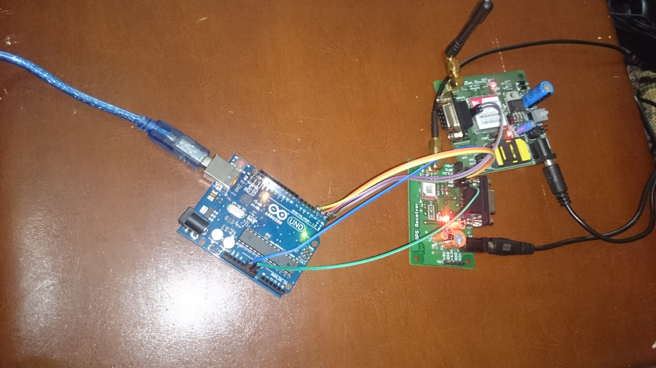
IMAGE OF THE WORKING MODULE

Slide 29
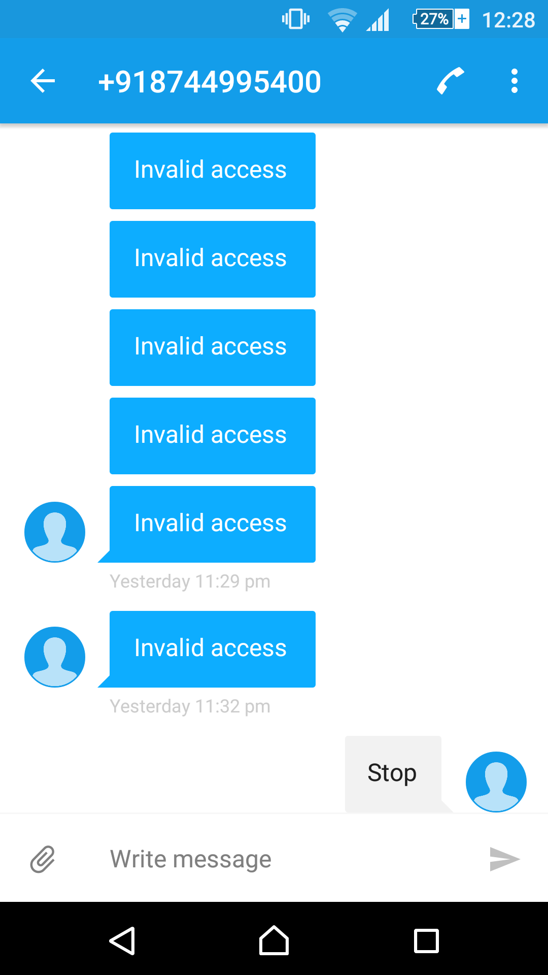
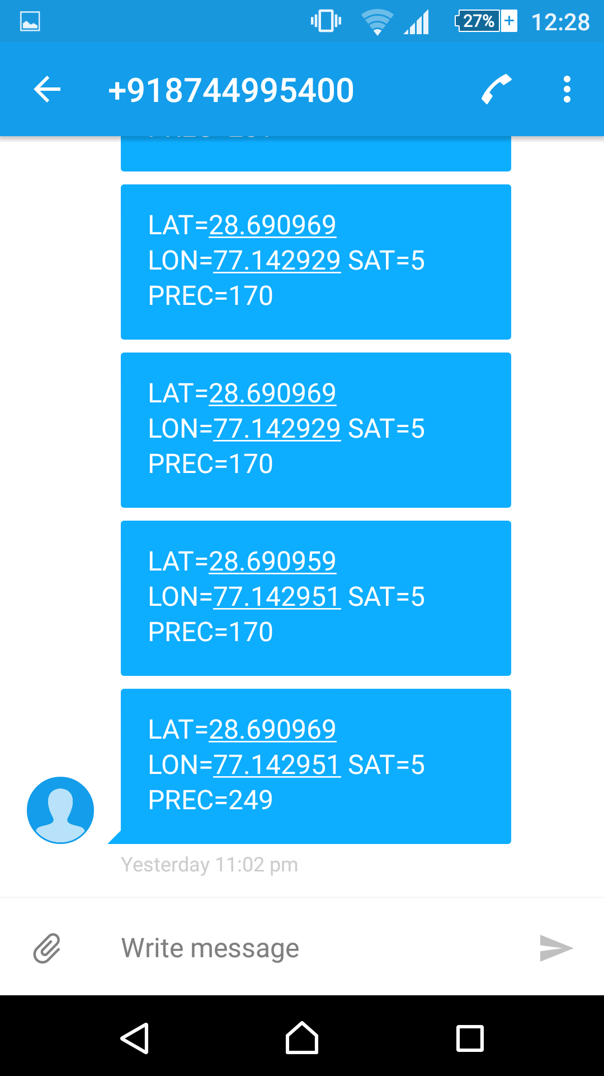
SCREENSHOTS OF THE MESSAGES RECEIVED

Slide 30
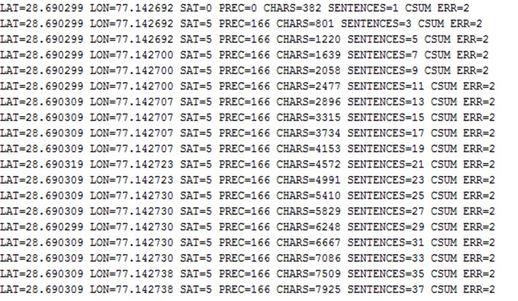
VALUE OF THE LATITUDE AND LONGITUDE
RECEIVED THROUGH GPS

Slide 31
CONCLUSION
The owner then receives the latitude and the longitude of the location where the vehicle is presently located.
This can then be informed to police for successful arresting of the thief as well as the acquirement of the stolen vehicle.
The product, apart from reducing the chances of theft, even helps in catching the culprits in such a way that they may not know that they are being tracked.
Vehicle tracking system is becoming increasingly important in large cities and it is more secured than other systems. Nowadays vehicle thefting is rapidly increasing , with this we can have a good control in it.The vehicle can be turned off by only with a simple SMS.
Since, nowadays the cost of the vehicles are increasing they will not step back to afford it.This setup can be made more interactive by adding a display to show some basic information about the vehicle and also add emergency numbers which can be used in case of emergency.
Upgrading this setup is very easy which makes it open to future requirements without the need of rebuilding everything from scratch, which also makes it more efficient

Slide 32
APPLICATIONS AND ADVANTAGES
APPLICATIONS
Stolen vehicle recovery .
Field service management.
It is used for food delivery and car rental companies.
ADVANTAGES:
Compact, flexible, durable
Remotely Accessible
Easy to manufacture and implement
Extremely accurate
Helps in smart monitoring of the vehicle
Lowers chances of theft
High chances of recovery in case of theft

Slide 33
SHORTCOMINGS
GPS cannot penetrate forest cover, parking garages, or other obstructions. GPS relying on a short visible antenna can easily be broken off by a thief. Dead reckoning can be used to predict position of the vehicle during a GPS outage.It’s first time reading takes around 15 minutes to configure. It’s connection can be easily broken off by change in location or if it is on after a gap of time requiring it to again take that time frame for successful connection.

Slide 34
QUESTION AND ANSWER

